Slide 1
Hunt for QCD Axion miniclusters and Primordial Black Holes
Akshank, Chirag, Mehul, Suryansh
Mentor : Manish Tamta

Slide 2
Table of Contents
01
02
03
04
05
Introduction to Dark Matter
Axion Dark Matter
Gravitational Lensing
Axion Miniclusters
Primordial Blackholes

Slide 3
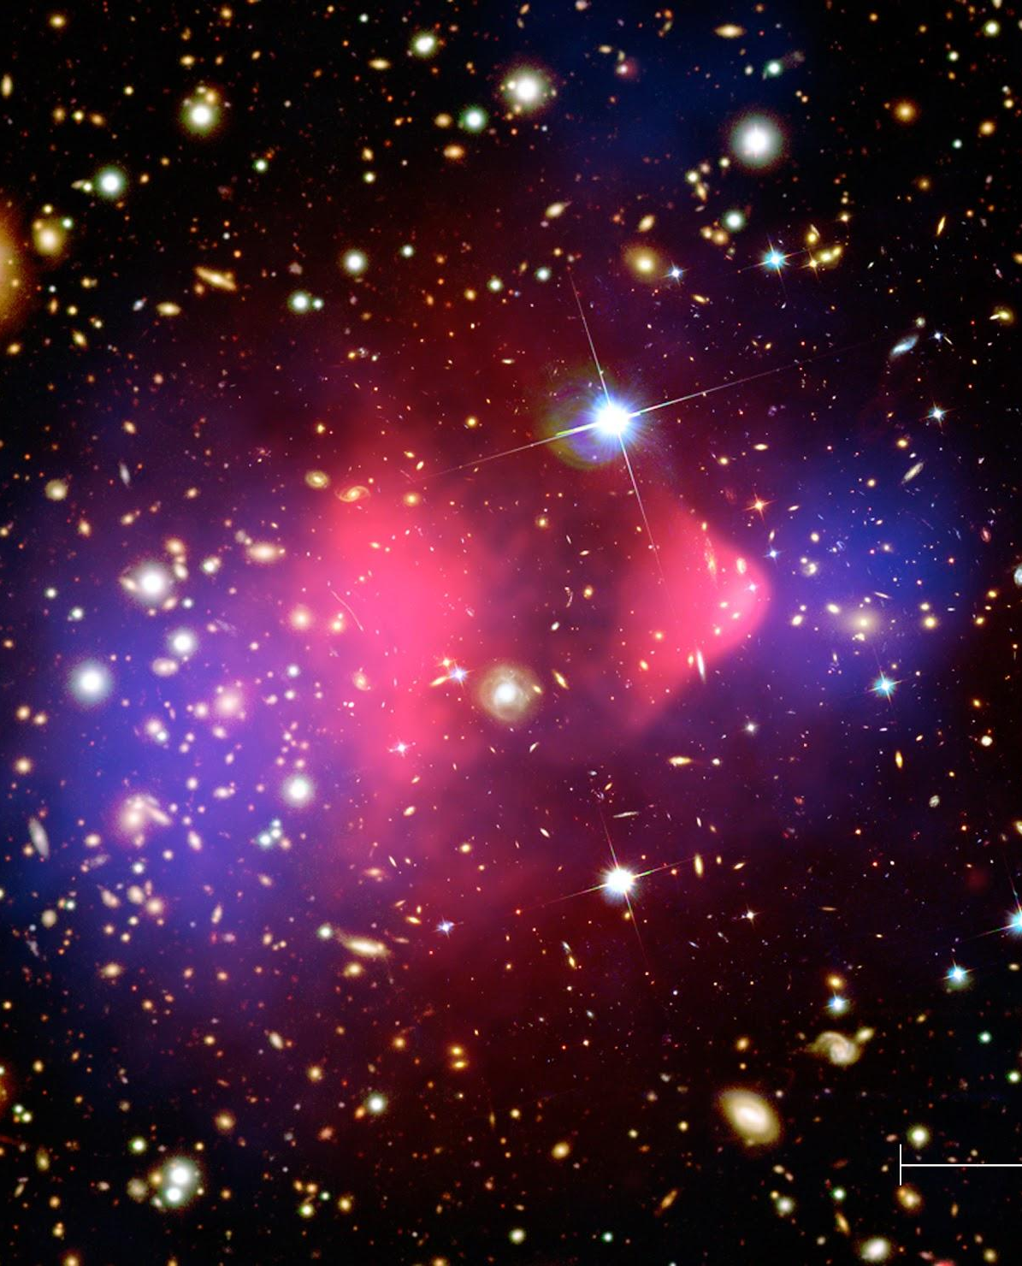
01
Introduction to Dark Matter

Slide 4
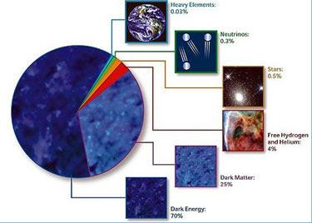
What is Dark Matter?
Composition of mass-energy content of the Universe. Dark Matter makes up around 84% of the matter content

Slide 5
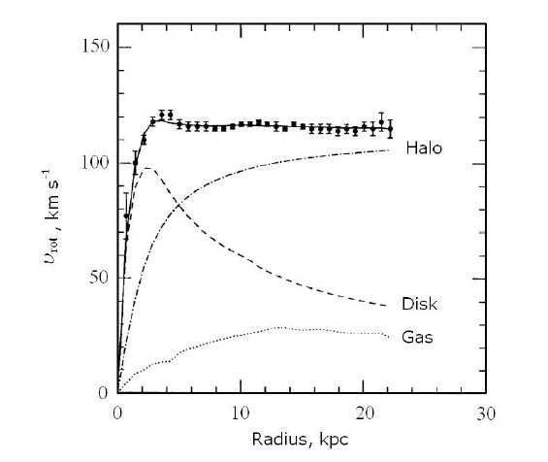
Galaxy Rotation Curves
Dark matter halos provide the necessary force to maintain these high velocities far from the galactic centre

Slide 6
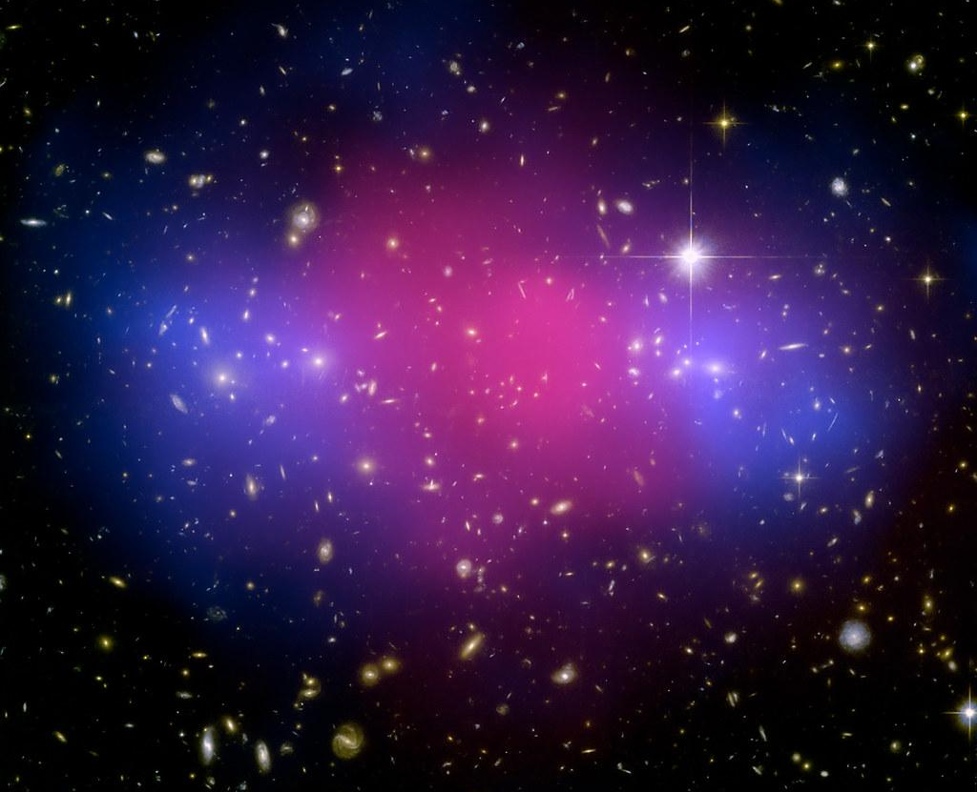
Gravitational Lensing
Observations of Gravitational Lensing effects in the Bullet Cluster provide a direct proof of the existence of dark matter in galaxy clusters
Credits: NASA, ESA, CXC, M. Bradac (University of California, Santa Barbara), and S. Allen (Stanford University

Slide 7
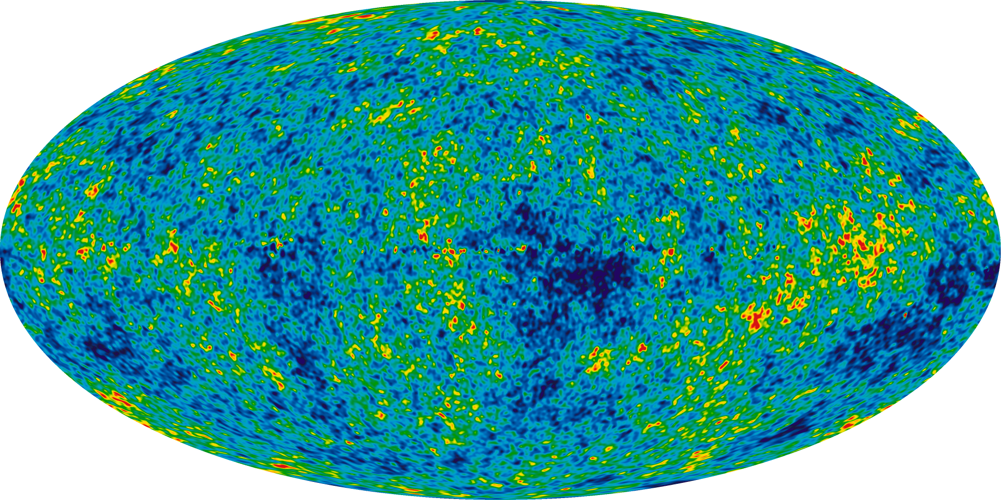
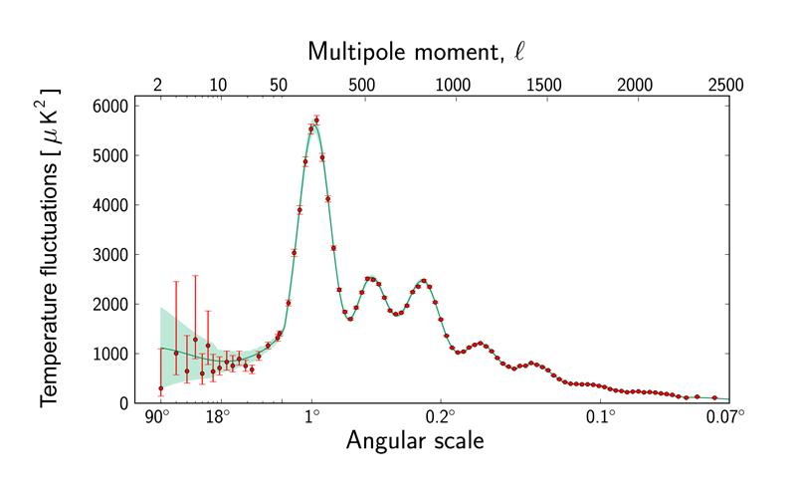
Evidence from CMB
The temperature anisotropies of CMB are excellent probes of cosmological parameters. The spectacular agreement between CMB and Lambda CDM model provides evidence for 26% of total energy density of the universe is in Dark Matter while ordinary matter accounts for only 5%.

Slide 8
Dark Matter Properties
Cosmic Density
Local Density
Velocity Dispersion
Dark Matter makes up ~ 26% of mass-energy density of universe & 84% of the matter content
~ 0.3 to 0.4 GeV cm−3, equivalent to one proton every few cubic centimeters or one solar mass per cubic lightyear.
The velocity dispersion of DM is around σ = 200 km s−1, and our local motion is in the direction of the constellation Cygnus.
Cold Dark Matter
Early Appearance
Weakly Interacting
Dark Matter must be non-relativistic and have negligible pressure.
Dark Matter was present even before CMB was formed as evident from galaxy clustering
Dark Matter cannot interact with itself or baryonic matter strongly

Slide 9
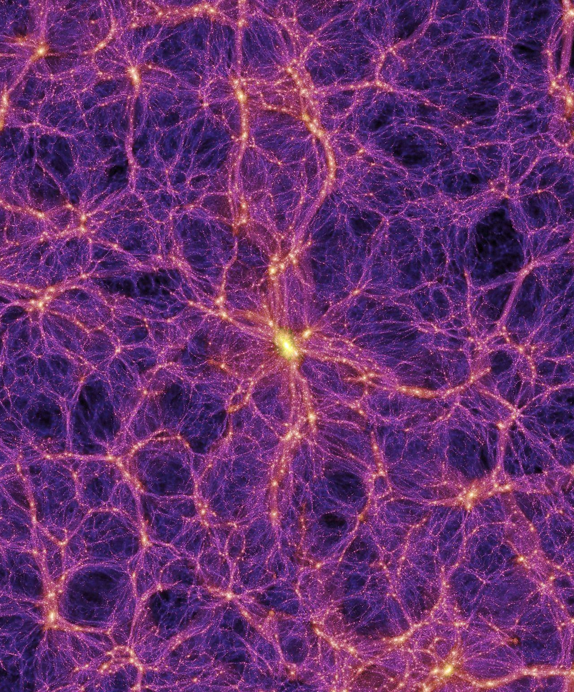
02
Axion Dark Matter

Slide 10
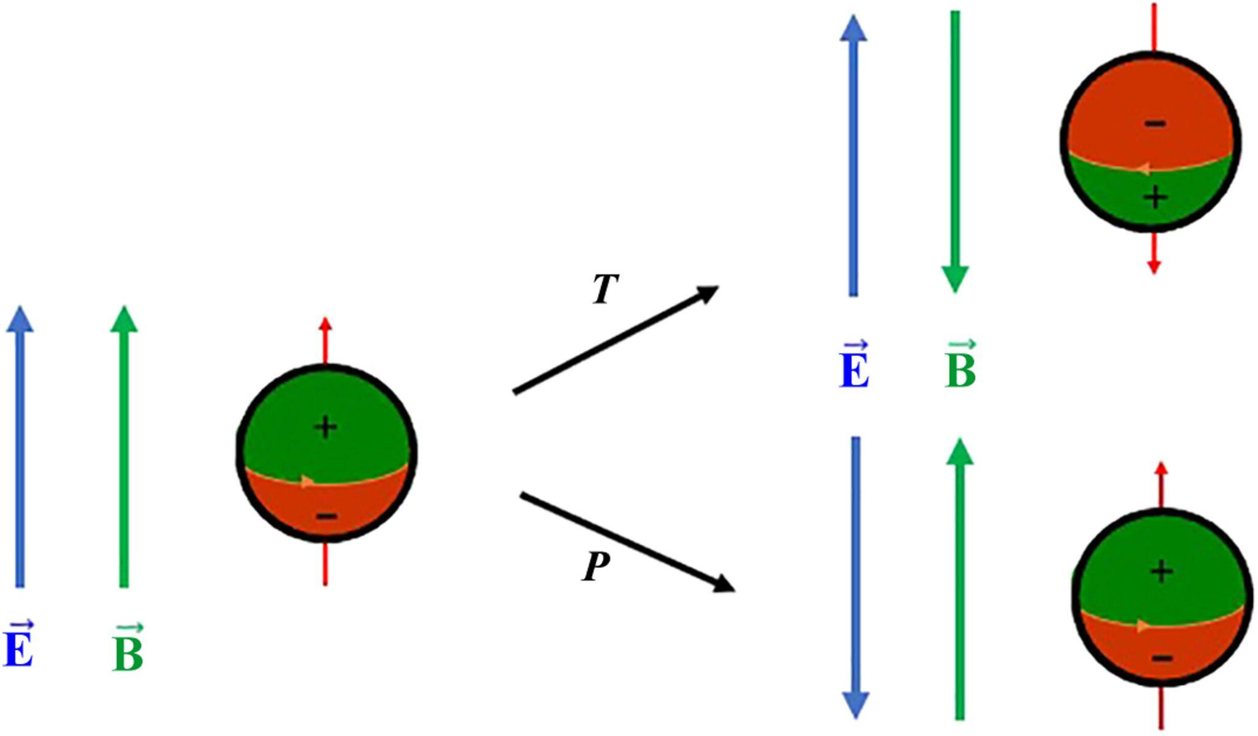
What are Axions?
QCD Axions were proposed as a solution to the Strong CP Problem in Quantum Chromodynamics
They evolve to have same energy density equation as cold matter and hence are candidates for cold dark matter
QCD Axions are extremely light particles (10^(-5) ev), and exist in the universe in a non-relativistic, coherent wave like state.
Illustration of CP violation
Credits : Chadha-Day et al. ,Sci. Adv.8, eabj3618(2022)

Slide 11
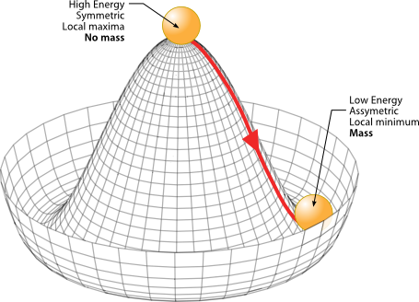
Higgs Discovery and Axions
Theoretical framework of QCD Axions shares the property of spontaneous symmetry breaking with Higgs Boson.
Credits : Frédéric Bellaiche

Slide 12
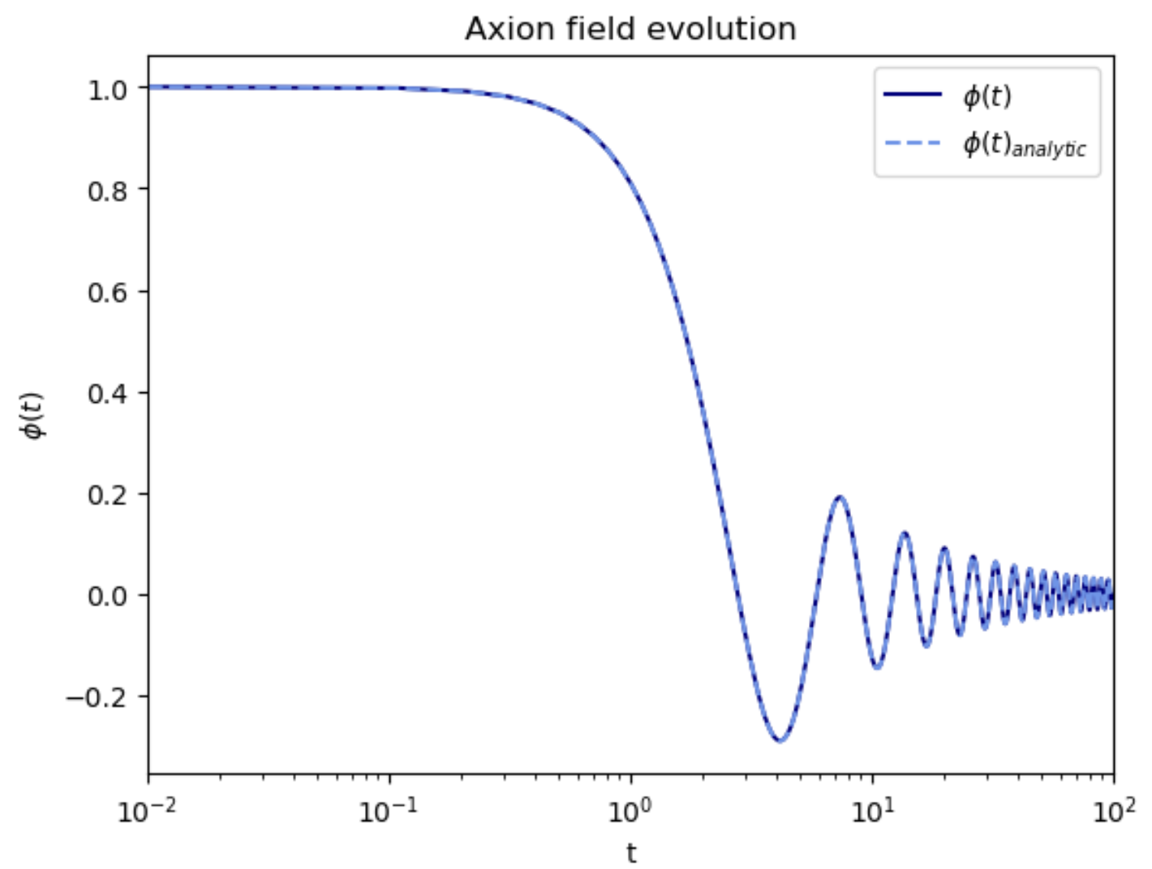
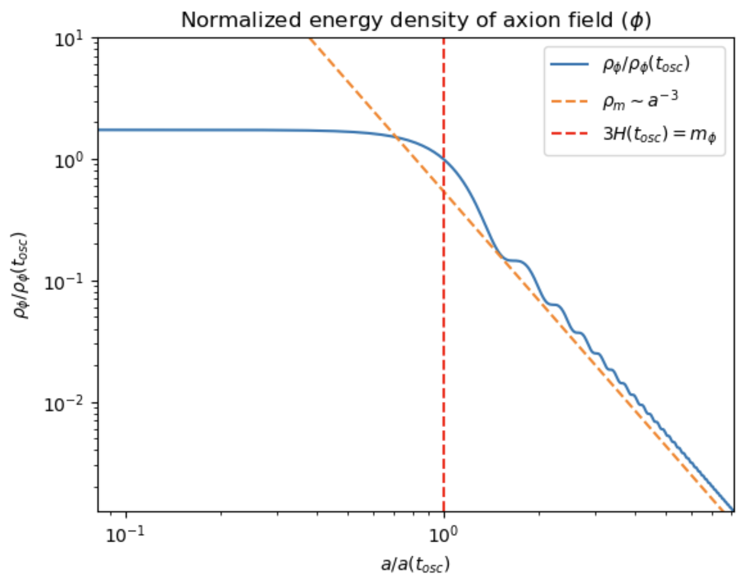
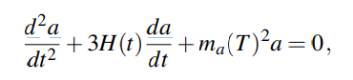
Axion Field Evolution
Under smooth initial conditions, axion field evolution is governed by the Klein Gordon Equation:
Credits : Manish Tamta

Slide 13
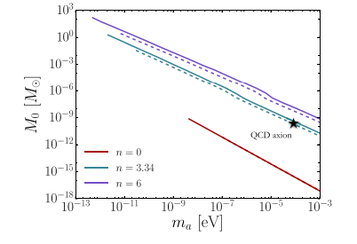
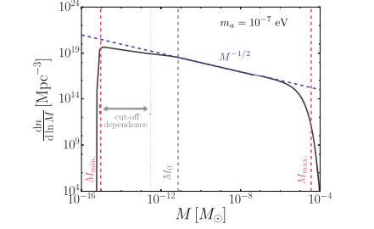
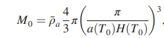
Axion Miniclusters
The axion minicluster characteristic mass is given by
The mass function of miniclusters determined through the Press - Schechter Formalism
Credits : Fairbairn et al. 2017

Slide 14
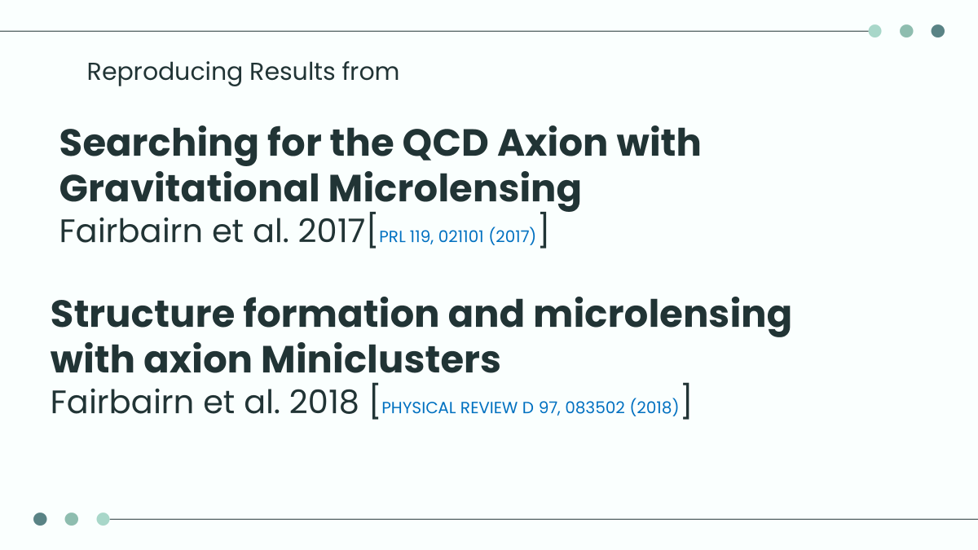

Slide 15
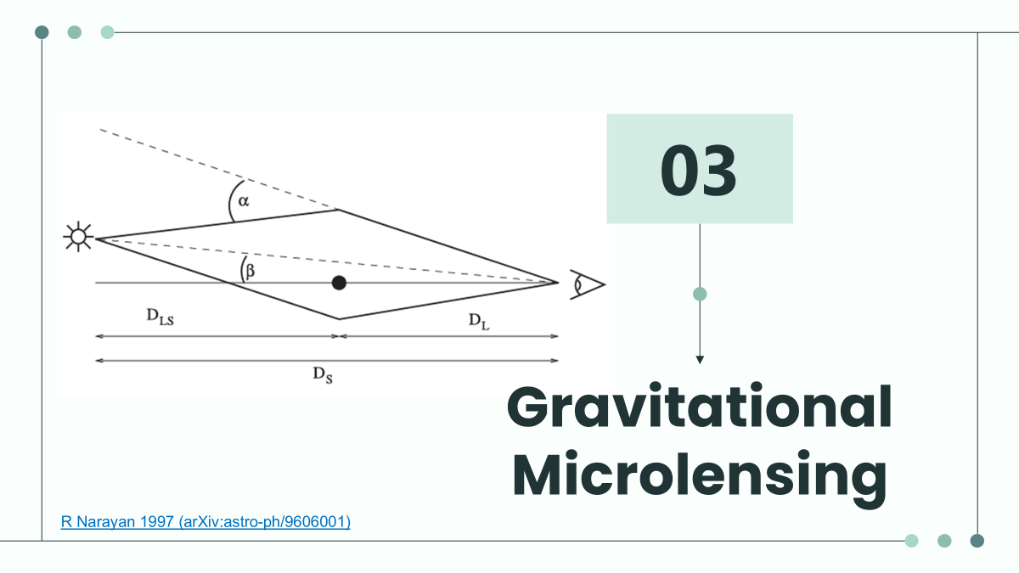

Slide 16
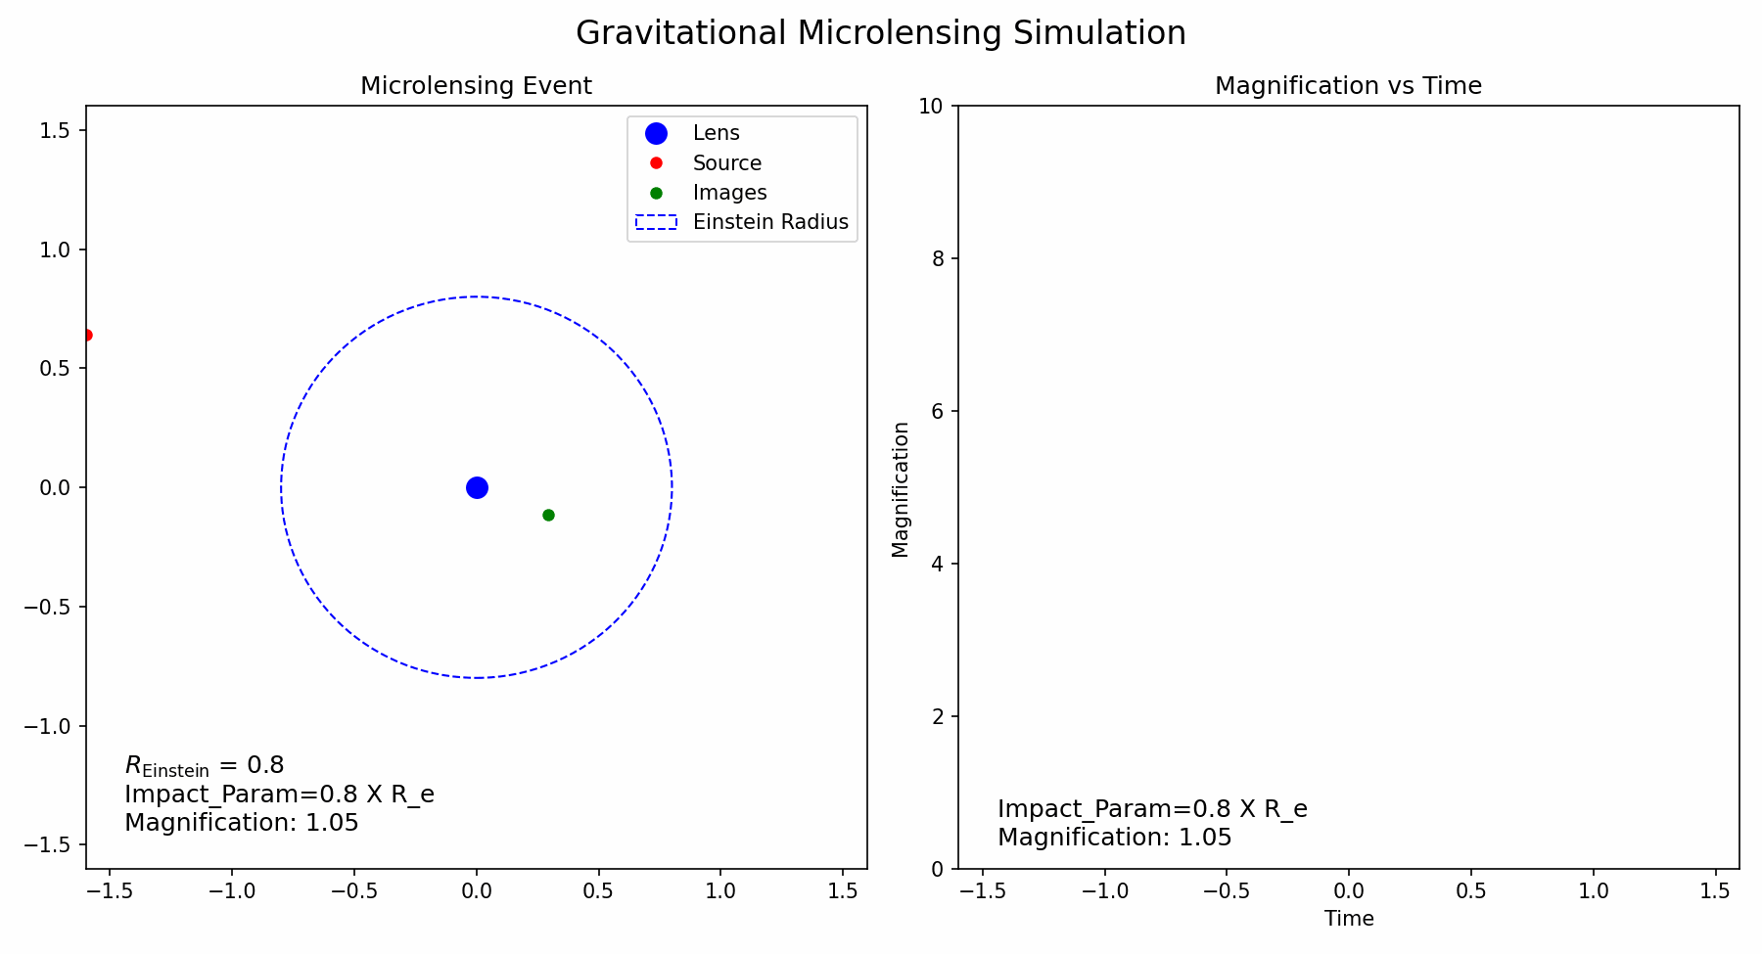
Microlensing Events

Slide 17
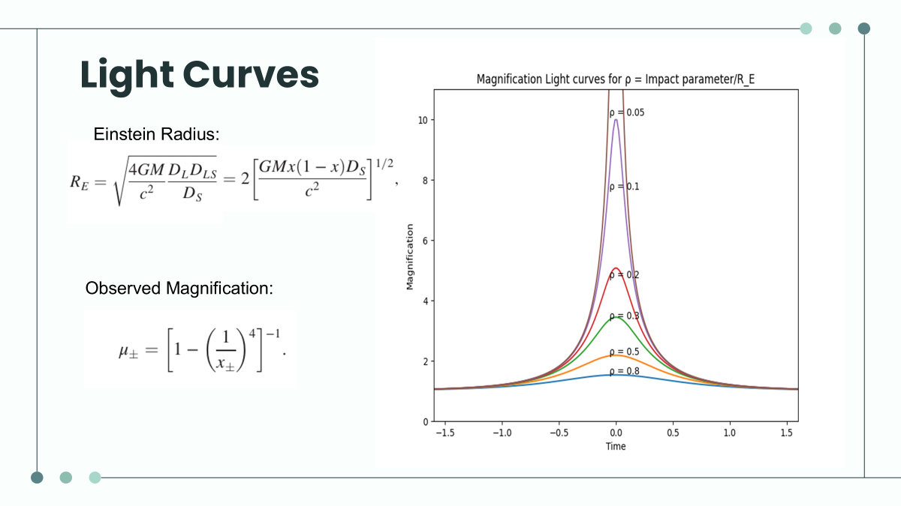

Slide 18

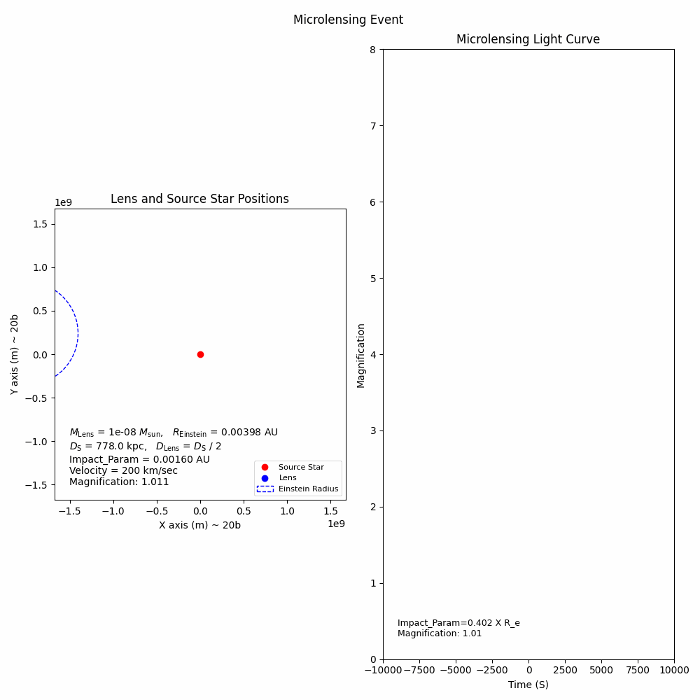

Slide 19
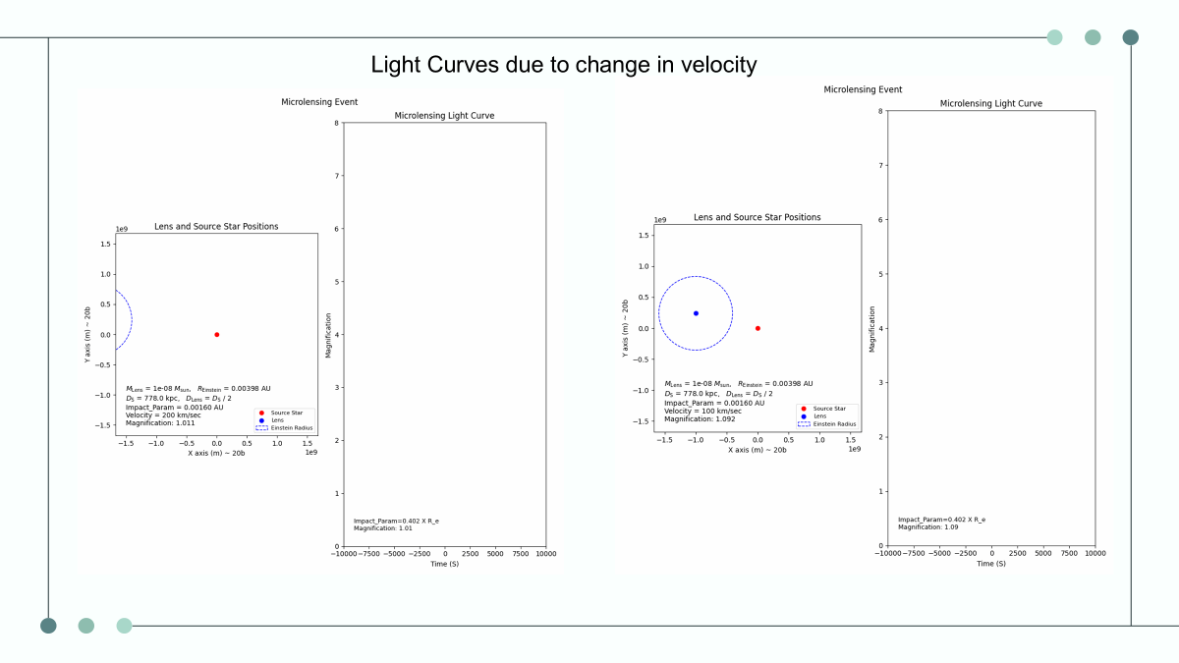
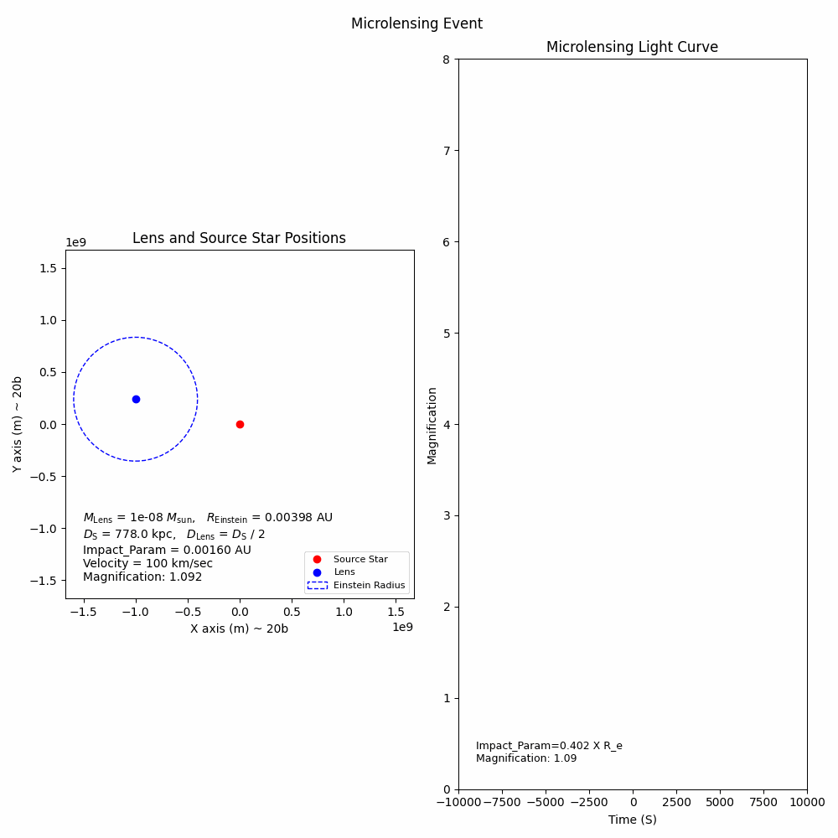

Slide 20
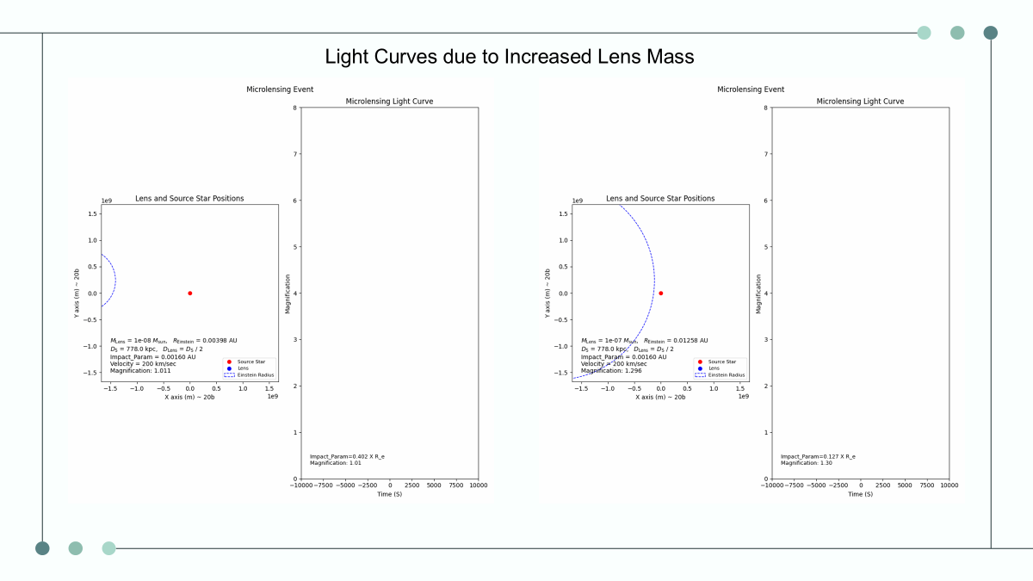
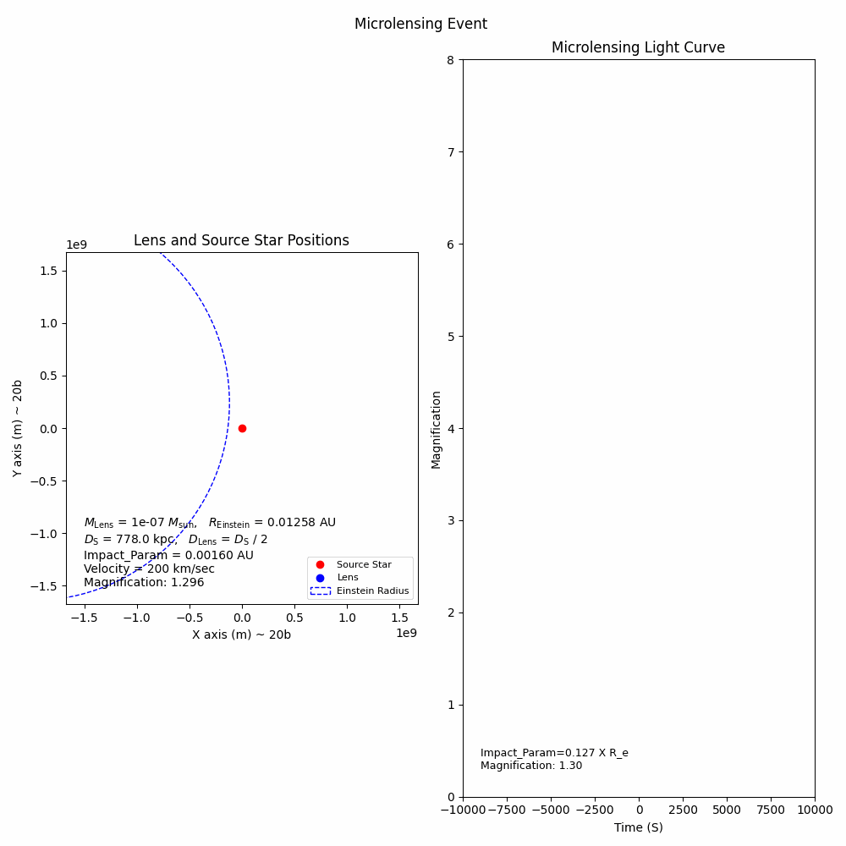

Slide 21
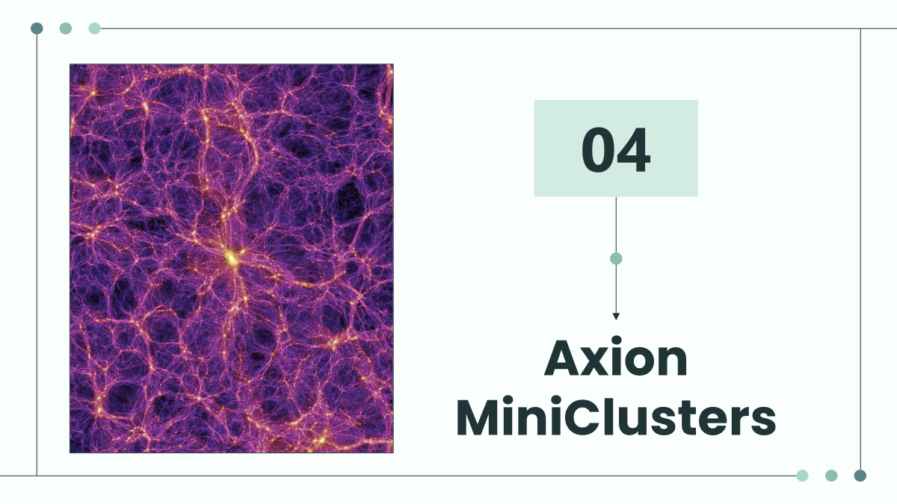

Slide 22
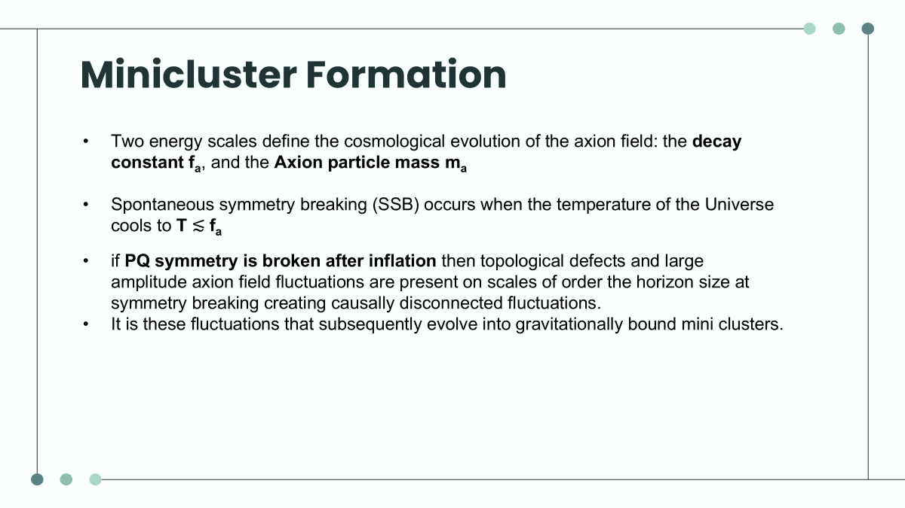

Slide 23
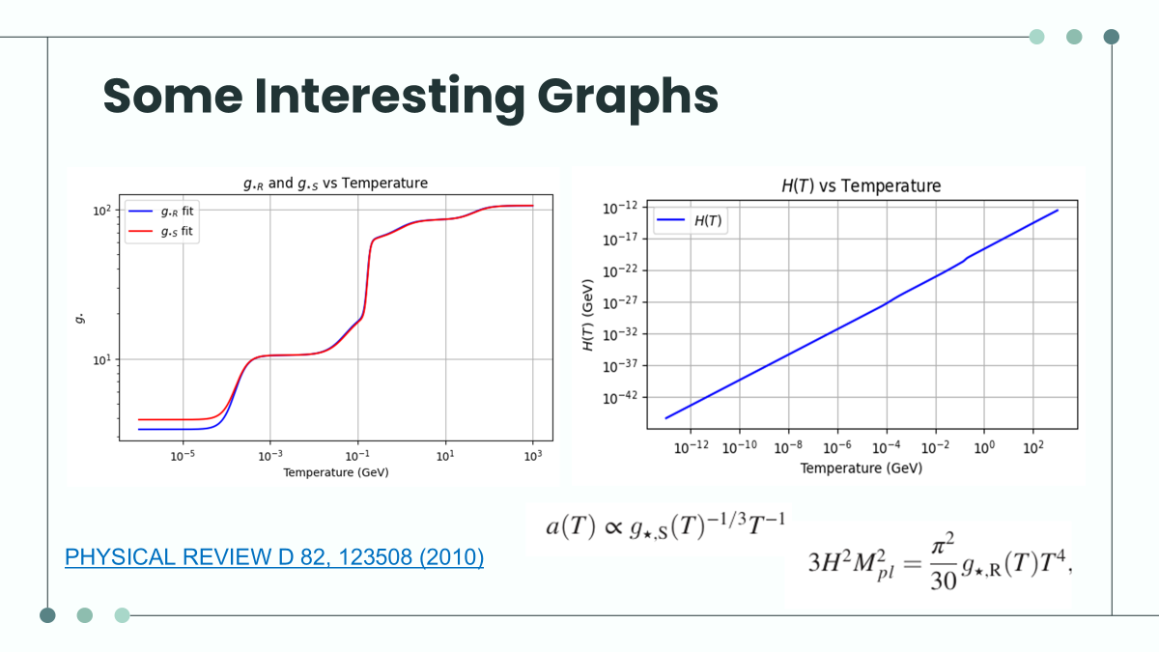

Slide 24
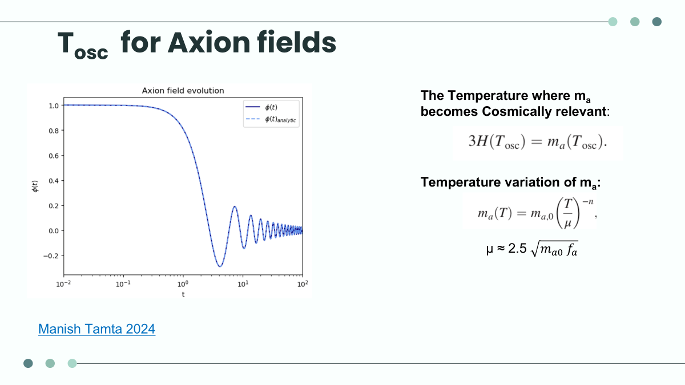

Slide 25
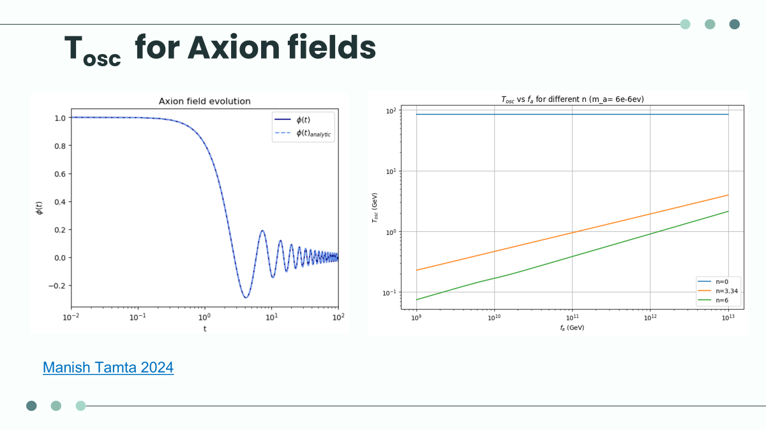

Slide 26
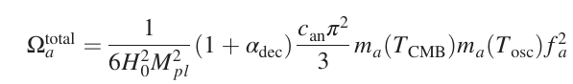
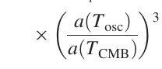
F_{a} vs m_{a}

Slide 27
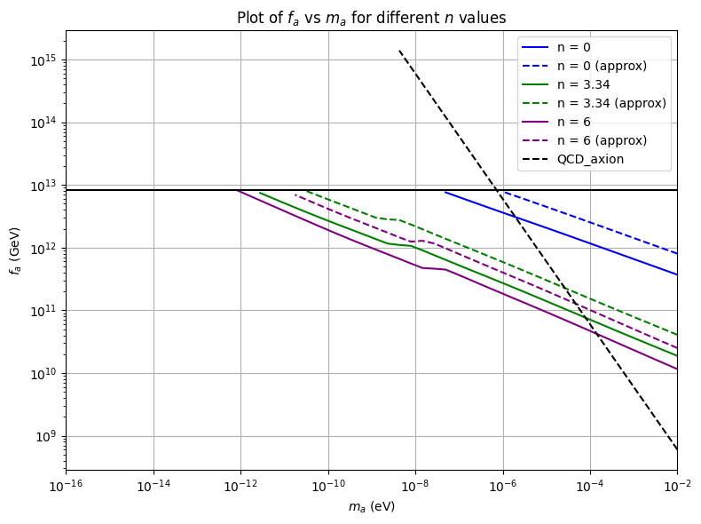
F_{a} vs m_{a}

Slide 28
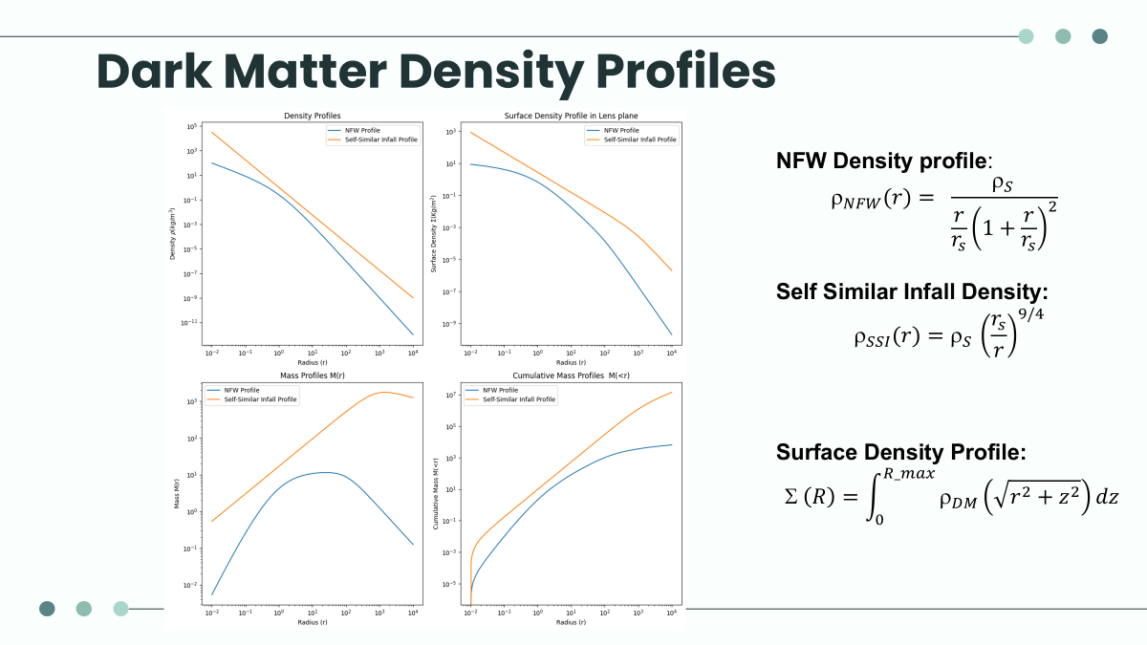

Slide 29
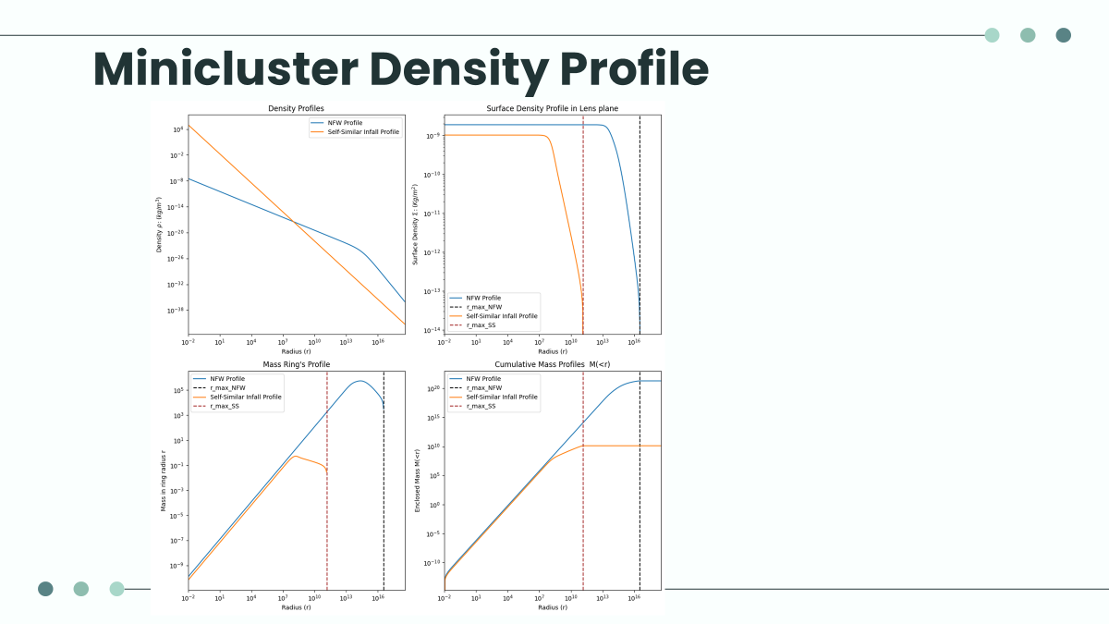

Slide 30
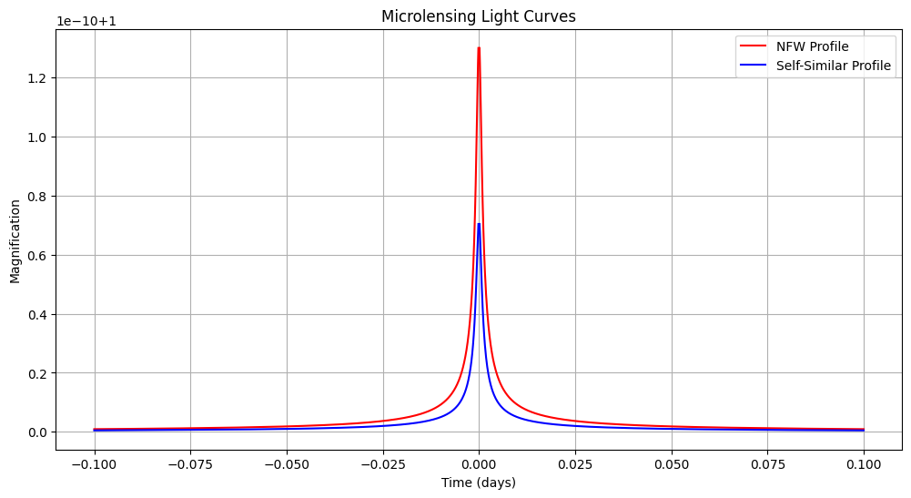
Minicluster Microlensing events

Slide 31
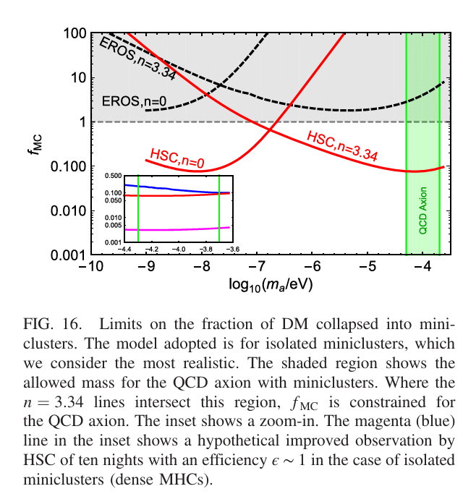
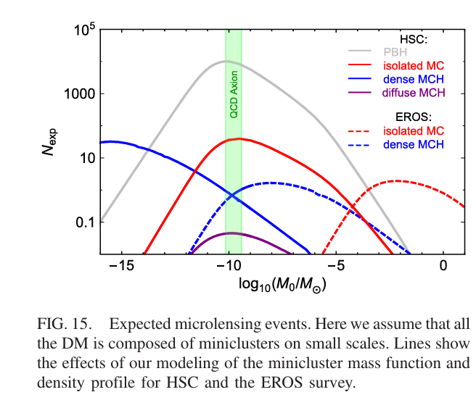
Results: MICROLENSING CONSTRAINTS ON AXIONS
PHYSICAL REVIEW D 97, 083502 (2018)

Slide 32
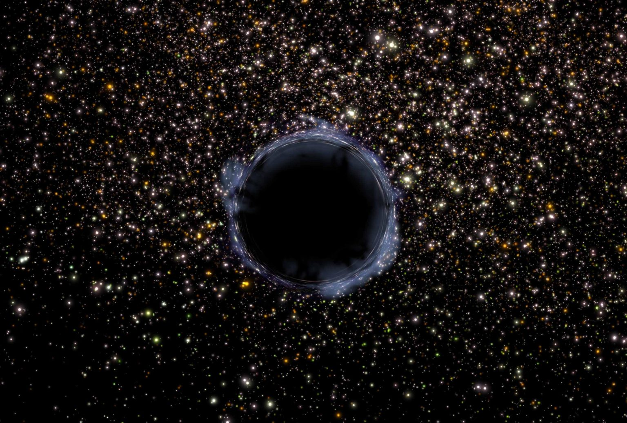
05
Primordial BLack Holes
Credit: NASA / G. Bacon (STScI)

Slide 33

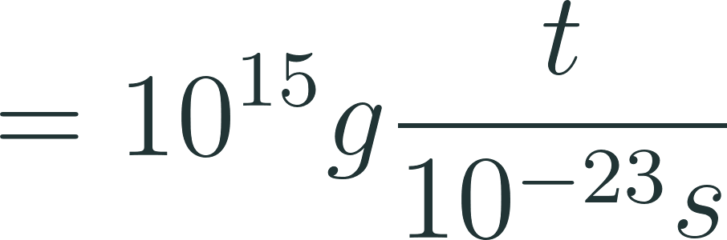
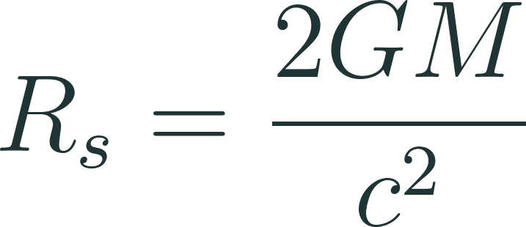
What are Primordial Black Holes?
“Old Black Holes”
PBH are black holes that formed in the early universe by the collapse of large density perturbations at small scales.
Mass Range
Size Range
subatomic particle to several hundred km

Slide 34
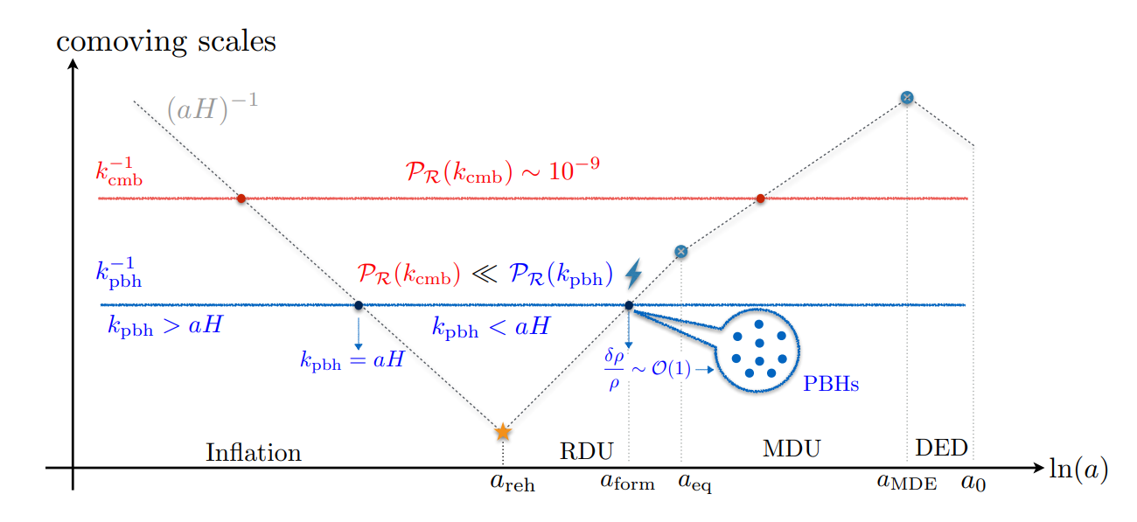
Formation of PBH: a causal process
Credit: Ogan, Tasinato (2023)

Slide 35
PBH as Dark Matter Candidates?!
Cold!
PBH are cold i.e. non-relativistic!
Non-baryonic!
PBH formed from the collapse of density perturbations in early universe i.e. before Big Bang nuclesynthesis.
Stable?
Large mass PBH have lifetime greater than the age of the universe.

Slide 36
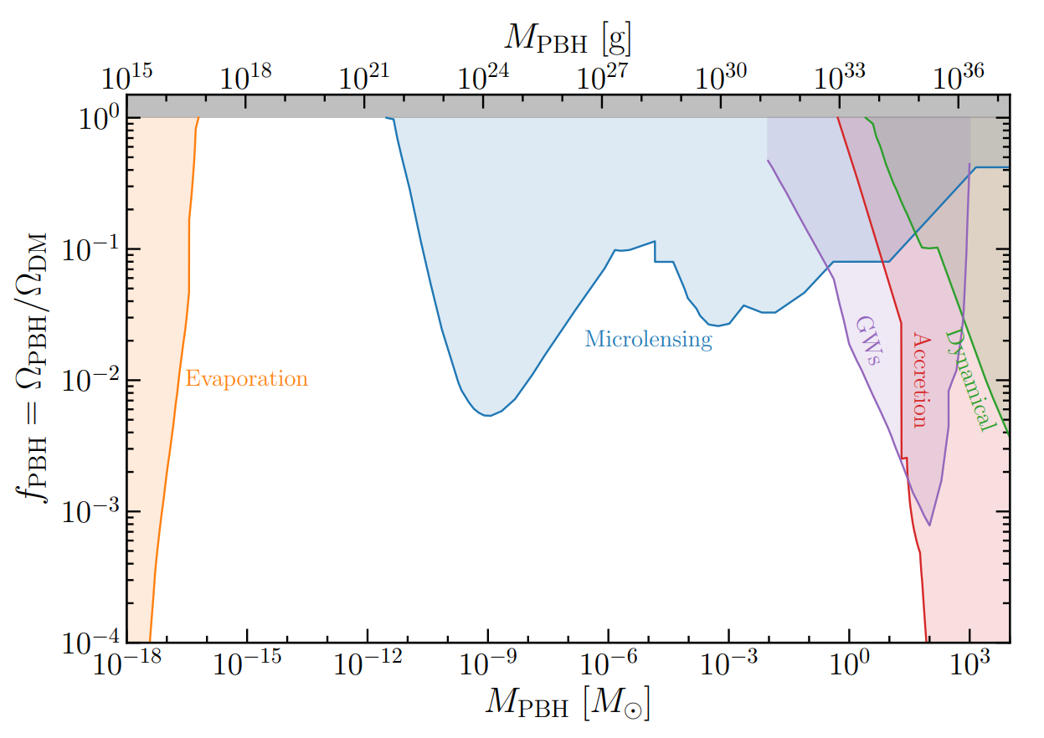
“Observing” PBH
Lensing
Dynamic & Accretion
Gravitational Waves
Credit: Marc Oncins (2022)

Slide 37

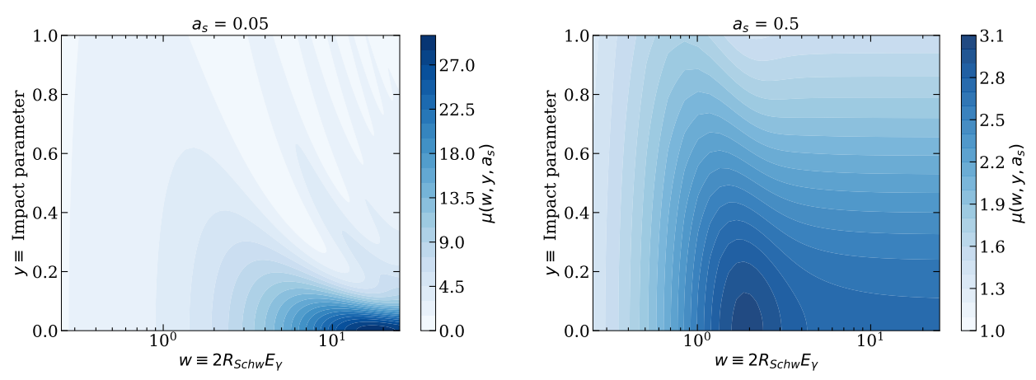
Using Xray Microlensing to study PBH
In mass range
Credit: Manish, Nirmal, Prateek (2024)

Slide 38
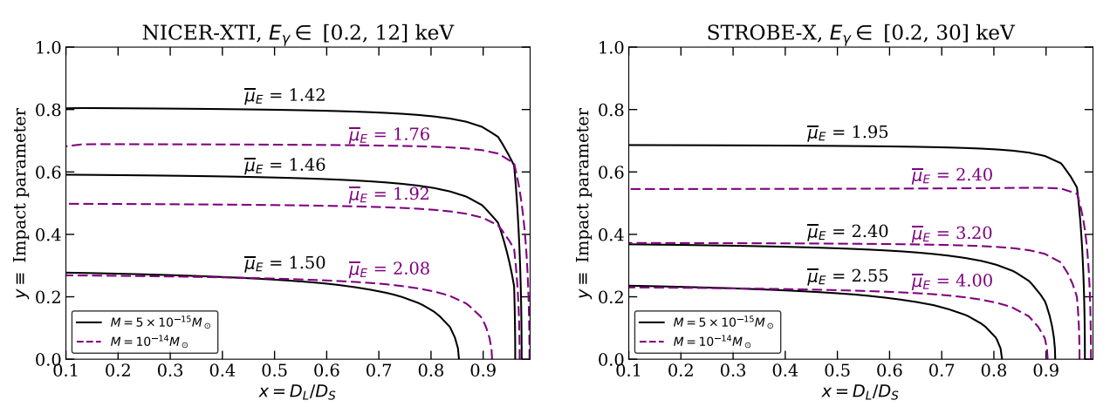
Using Xray Microlensing to study PBH
In mass range
Credit: Manish, Nirmal, Prateek (2024)

Slide 39
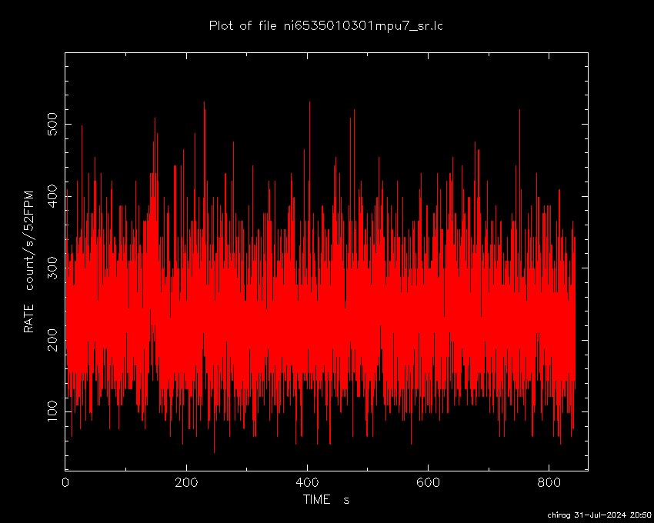
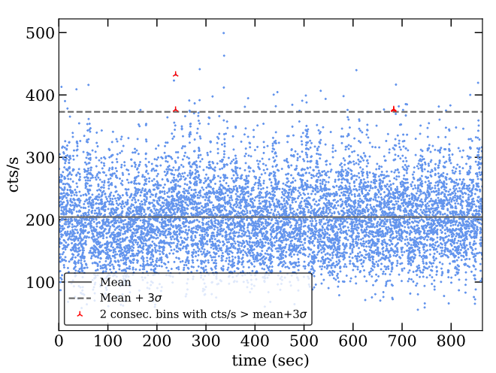
How to identify microlensing events?
Light curve for a 864 s segment of NICER observation of SMC X-1 extracted using HEASOFT
Credit: Manish, Nirmal, Prateek (2024)

Slide 40
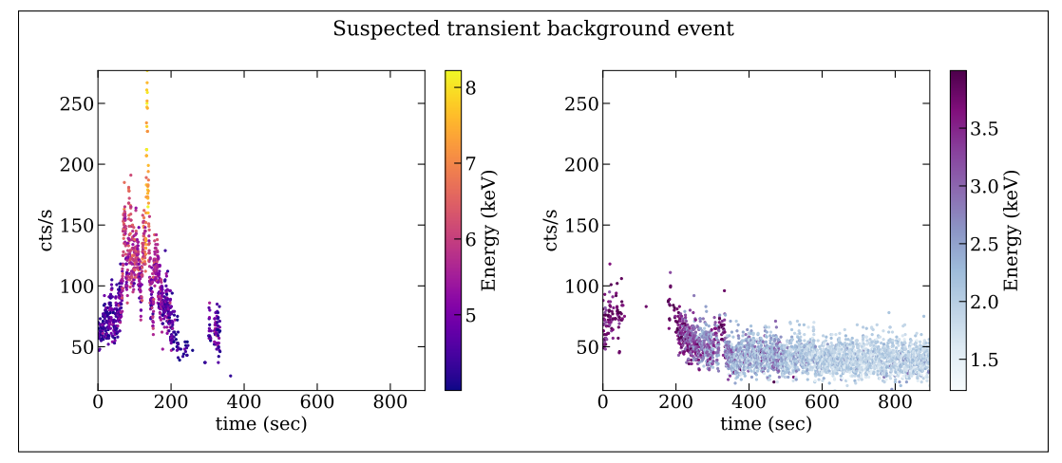
How to identify microlensing events?
Credit: Manish, Nirmal, Prateek (2024)
arXiv:2405.20365

Slide 41
Thank You !

